Slide 1
Sharing Wisdom:
Effective Faculty Orientations
Chief Academic Officers Annual Meeting
July , 2014
www.ilisagvik.edu
Notes:
Aviqtuaqatigiigniq

Slide 2
NEW FACULTY ORIENTATION - PURPOSE
An introduction to the mission, culture, programs, resources, and community of teaching and learning at Columbia College Chicago (2 days)
---
To better acquaint new faculty with the many resources that Georgia Gwynnett College has to offer (13 days)
---
The New Faculty Orientation program is intended to introduce new faculty to the Academic culture at Whitman College and to assist new faculty in final preparations for the academic year (3 days)
www.ilisagvik.edu
Notes:
1 – Columbia College Chicago
2 – Georgia Gwynnett College
3 – Cornell College
4 – Whitman College

Slide 3
NFO - PURPOSE, Cont’d
To introduce faculty to one another and to provide basic information about Cornell College. Orientation sessions continue throughout the first year, focusing on topics of interest such as grading standards, writing assignments, the faculty governance system, advising, and writing letters of recommendation (1 week)
---
FSU College of Medicine recognizes the importance of an orientation program to provide professional support and familiarity with the mission, infrastructure, policies, and procedures ... The new faculty orientation program notebook is designed to ...
www.ilisagvik.edu

Slide 4
Effective faculty orientations vary in format and content, reflecting the diversity of institutions.
www.ilisagvik.edu

Slide 5
ORIENTATION TOPICS - CATEGORIES
Policy & Procedures
Technology
Use of electronic administrative systems
Use of instructional electronic infrastructure
Pedagogy
Regulatory Compliance
Social Interaction/Team Building
Culture
www.ilisagvik.edu
Notes:
Policy & Procedure – Employee or Faculty HB/how to order textbooks/
Technology- CAMS – submitting grades, attendance
Instructional electronic infrastructure – email, library, moodle, blackboard, etc.
Pedagogy – Engaging students, place-based learning actvities,
Regulatory
Accreditation
First Aid
OSHA
FERPA
Anti-Discrimination/Harassment
Social Interaction/Team Building
Cultural Orientations
Organizational culture, Native culture

Slide 6
IḶISAĠVIK FACULTY & STAFF ORIENTATIONS
New full-time faculty
Returning full-time faculty
Adjunct faculty on-site
Adjunct faculty off-site
Staff
Administration
Challenge
Individual needs/relevance for all
www.ilisagvik.edu
Notes:
Small institution – about 110 full-time/part-time employees
13 FT faculty
20-30 PT faculty

Slide 7
IḶISAĠVIK FACULTY & STAFF ORIENTATION
Fall Faculty & Staff Orientation (2-4 days)
HR Orientation (1 day)
Adjunct Faculty Orientation (1/2 day)
Faculty Mentorship (ongoing)
www.ilisagvik.edu
Notes:
Small institution – about 110 full-time/part-time employees
13 FT faculty
20-30 PT faculty

Slide 8
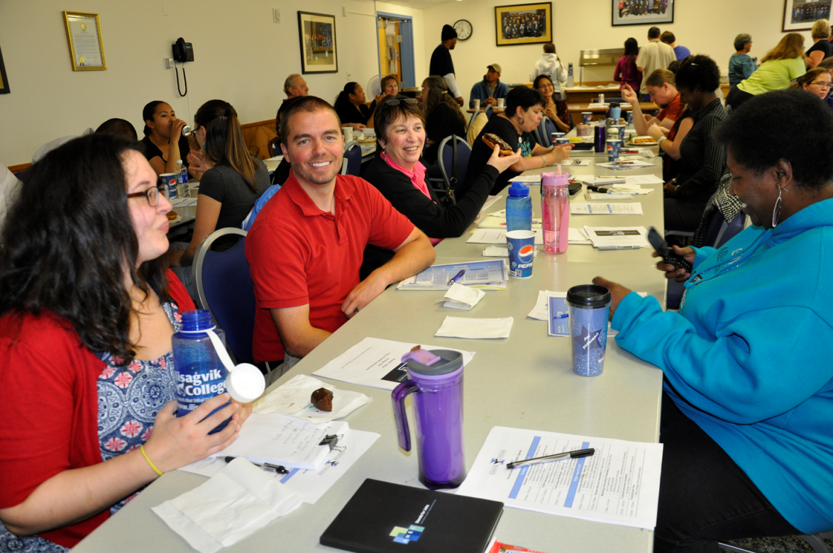
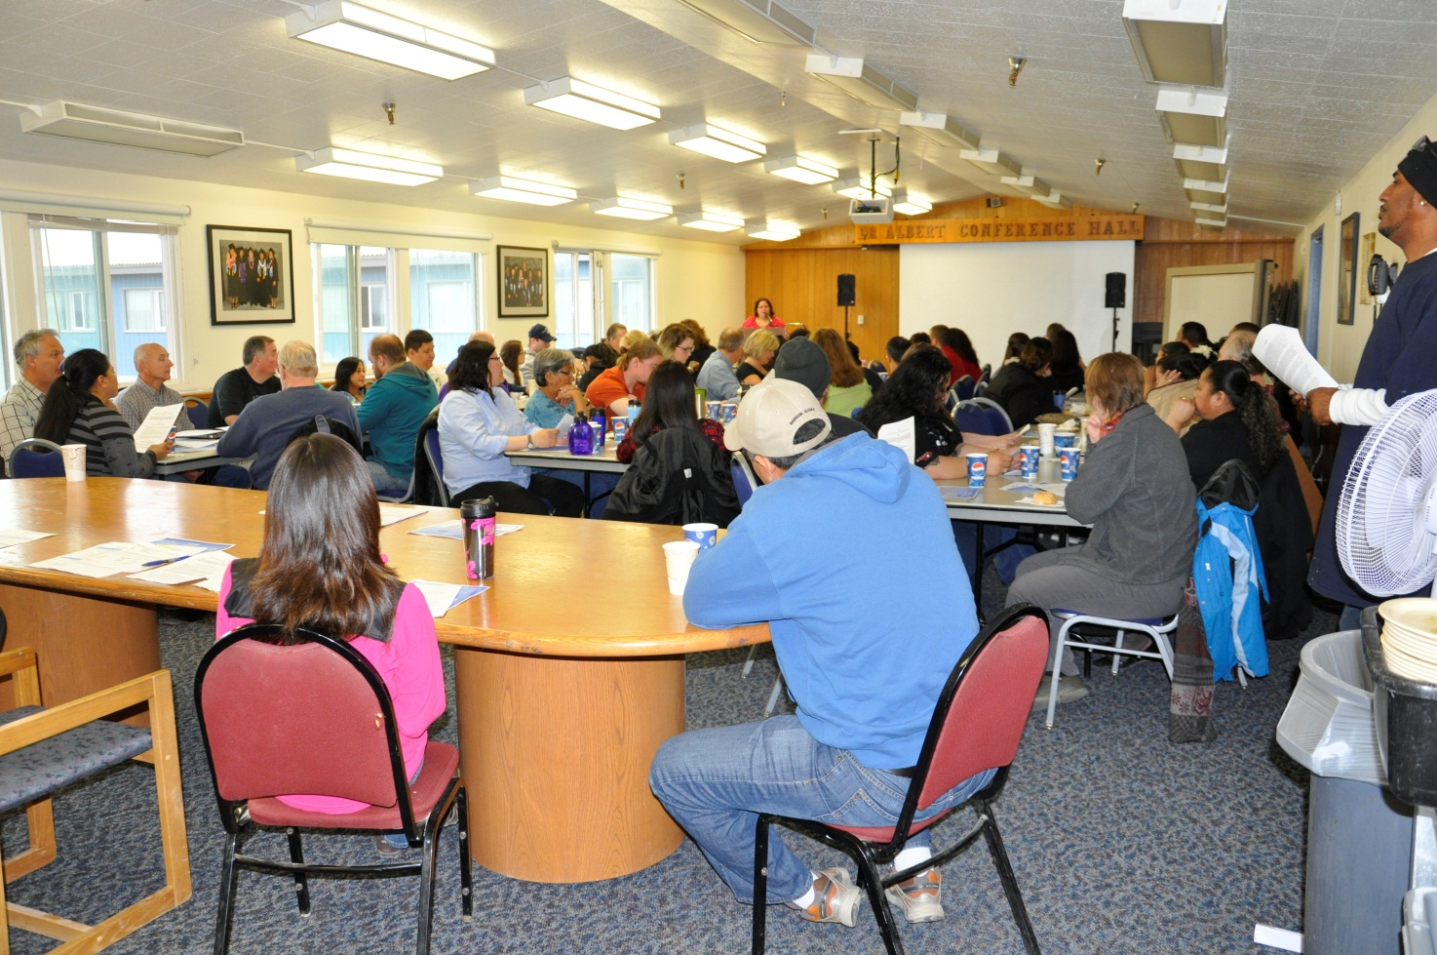
Faculty
Staff

Slide 9
FALL ORIENTATIONS – COMMON ELEMENTS
Welcome-back breakfast**
Department presentations – accomplishments**
Review of strategic plan**
Human Resources, Q&A**
Business office**
Team building activities**
Library orientation (Community resources)*
Marketing & Recruiting**
Student Success Center**
Technology**
Faculty Outreach*
Dean’s Council*
Closing potluck, barbeque, etc.**
www.ilisagvik.edu
Notes:
HR – updates to handbook, insurance, retirement,
BO – Bookstore
Teambuilding –
Robotics
Procedures, - TA, Timesheets, dept. codes Purchase orders,
Marketing & recruiting –
Branding – college letter head, PPTs, ads
Faculty – promote course, recruiting strategies
Student Success Center
LRC –
Referrals
First Year Seminar
Technology
CAMS
Windows 7
Moodle
Email

Slide 10
Sample Activities
Team building activities
Robotics
Scavenger hunt
Problem solving
Technology
Workshops on MS Office 2010
Moodle Workshops
Distance Ed Team (iSpring, electronic flashcards, cLive)
Faculty outreach/village visits
Dean’s Council
www.ilisagvik.edu
Notes:
Faculty – Village visits - Caitlin

Slide 11
GUEST SPEAKERS
Principles of Adult Learning
Instructional Design
Hidden Disabilities and Assistive Technology
Suicide Prevention
Academic Advising
Culture & Education
www.ilisagvik.edu

Slide 12
FALL 2014
2 Days – Faculty & staff
1 Day – Workshops for faculty by faculty
Advising
Faculty Roles & Accreditation Standards
Department Meetings
Curriculum Innovation: Ideas for integrating culture and technology in the classroom
Wish lists for coming year (budget)
1 Day – “Elective” Workshops
OSHA Overview - FERPA
Valic (Retirement) - Rosetta Stone
Technology/Netiquette - First Aid/CPR
Green Team
HR Question & Answers
CAMS
www.ilisagvik.edu

Slide 13
ADJUNCT FACULTY
Online Orientation
Introduction
Getting Started
Responsibilities
Contacts
Resources
Policies
CAMS
MyCampus (Moodle)
In-person/teleconference
www.ilisagvik.edu

Slide 14
FACULTY MENTORSHIP
Full-time faculty
New faculty are assigned a faculty mentor
Help establish relationships with colleagues
Introduce the institutional framework as well as responsibilities of a faculty member
Orient the newcomer to the community
www.ilisagvik.edu

Slide 15
FACULTY MENTORSHIP
Adjunct faculty
Adjuncts are assigned a supervising faculty
Establish connection and sense of belonging to ‘college family’
Supervision & evaluation
Technology and instructional support
www.ilisagvik.edu

Slide 16
REFERENCES
Law, A. V., PhD., Jackevicius, Cynthia, PharmD., M.Sc, Le, J., PharmD., Murray, W. I., PhD., Hess, K., PharmD., Pham, D. Q., PharmD., & Min, D. I., PharmD. (2012). Impact of a faculty orientation and development committee. American Journal of Pharmaceutical Education, 76(1), 1-3. Retrieved from http://search.proquest.com/docview/1021175647?accountid=458
Schönwetter, D.,J., & Nazarko, O. (2008). Investing in our next generation: Overview of orientation and workshop programs for newly hired faculty in Canadian universities (part 1). The Journal of Faculty Development, 22(3), 214-222. Retrieved from http://search.proquest.com/docview/214588954?accountid=458
Savage, H., Karp, R., & Logue, R. (2004). Faculty mentorship at colleges and universities. College Teaching 52(1).
www.ilisagvik.edu

Slide 17
It’s your turn to share your wisdom!
What orientation format does your institution use?
What have been successful practices?
www.ilisagvik.edu

